Slide 1
Nuclear Energy 101
Argonne National Laboratory
Nuclear Engineering Division

Slide 2
Let’s start with a truly important energy engineering question:

Slide 3
How does your coffee pot work?
Why does the water pour out of your coffee pot’s filter basket into the pot below?
How does the water you put into your coffeepot go from the tank to the filter basket?

Slide 4
Coffee Pots: The Naked Truth
Water absorbs energy and heats up
Water’s density decreases with temperature
  Steam’s density is MUCH lower than liquid water
Hot, low density water rises to filter basket
  Added energy enables water to do some useful work
The work done by the water is called
NATURAL CONVECTION
Energy

Slide 5
What does this have to do with
NUCLEAR ENERGY?

Slide 6
What does this have to do with
ELECTRIC GENERATION?

Slide 7
How is a Power Plant like a Coffee Pot?
Energy
This is worth a closer look.
Images: www.tva.gov or Microsoft Office Clip Art Gallery

Slide 8
How is a Power Plant like a Coffee Pot?
Energy
First, we won’t need a coffee pot in a power plant.
Next we should probably look at things from a different angle.
Images: www.tva.gov or Microsoft Office Clip Art Gallery

Slide 9
How is a Power Plant like a Coffee Pot?
We need a bigger heat source than a coffee pot’s hot plate.
Images: www.tva.gov or Microsoft Office Clip Art Gallery

Slide 10

How is a Power Plant like a Coffee Pot?
We’ll burn something (wood, coal, natural gas, oil) in a boiler.
Now let’s make some electricity!
Images: www.tva.gov or Microsoft Office Clip Art Gallery

Slide 11
How is a Power Plant like a Coffee Pot?
Turbine/
Generator
Condenser
A turbine and generator makes electricity using the energy of the steam.
A condenser turns the used steam back to water.
Images: www.tva.gov or Microsoft Office Clip Art Gallery

Slide 12
How is a Power Plant like a Coffee Pot?
Turbine/
Generator
Condenser
How do we control how much electricity we make?
Images: www.tva.gov or Microsoft Office Clip Art Gallery

Slide 13
How is a Power Plant like a Coffee Pot?
Turbine/
Generator
Condenser
Pump
A pump allows us to control how much water is available to the heat source to make steam.

Slide 14
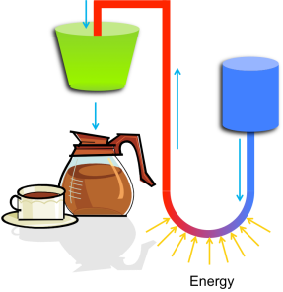
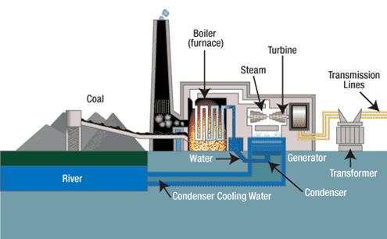
How is a Power Plant like a Coffee Pot?
Take a closer look at a coal fired power plant.
Can you find:
1) the Boiler 2) the Turbine 3) the Generator 4) the Condenser
Images: www.tva.gov or Microsoft Office Clip Art Gallery

Slide 15
How is a nuclear power plant different?

Slide 16
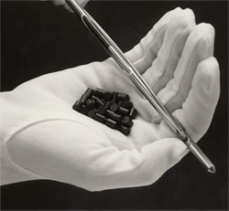
It’s the Fuel!
Nuclear power plants use the energy stored in the nucleus of large atoms rather than the energy stored in weaker chemical bonds.
Photo: Yucca Mountain Project website of the Office of Civilian Radioactive Waste Management [http://www.ocrwm.doe.gov/ymp/about/keyfacts.shtml]

Slide 17

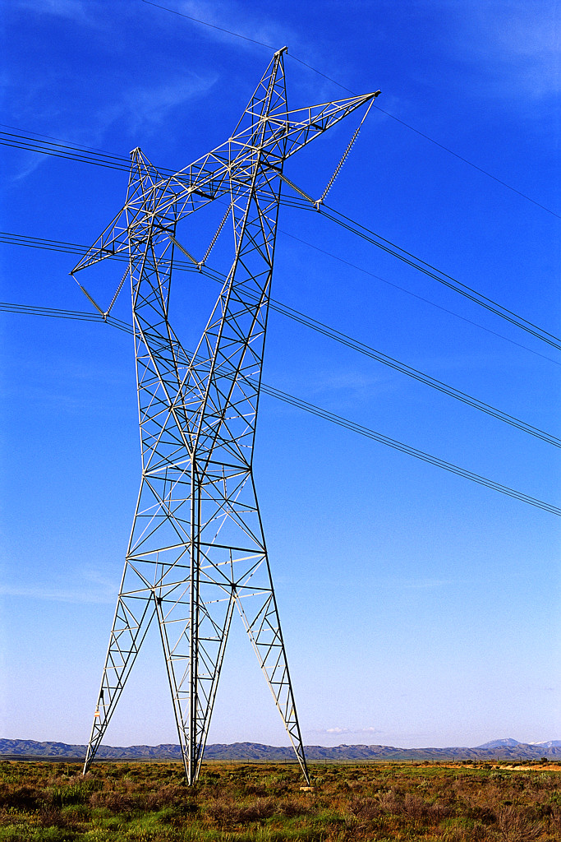
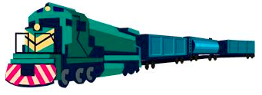
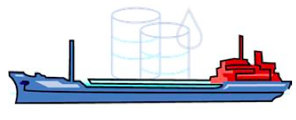
It’s the Fuel!
To Power 1000 Homes
150 Tons of Uranium
2,100,000 Tons of Coal
10,000,000 Barrels of Oil
Images: Microsoft Office Clip Art Gallery

Slide 18
What is Nuclear Fission?
If the nucleus of a heavy atom (such as Uranium) absorbs a neutron, the nucleus can become unstable and split.
This is called NUCLEAR FISSION.
Neutron
Uranium
Nucleus
Images: Original art by Dave Pointer

Slide 19
What is Nuclear Fission?
The nucleus splits in two halves and releases some neutrons, and radiation
Images: Original art by Dave Pointer

Slide 20
What is Nuclear Fission?
During fission, a small amount of mass is lost. This mass is transformed into ENERGY, which is also released.
E=mc²
Images: Original art by Dave Pointer

Slide 21
Let’s Build a Nuclear Power Plant
Questions? Send them to neoutreach@anl.gov

Slide 22
Let’s Build a Nuclear Power Plant
First, ceramic fuel pellets are manufactured from uranium ore

Slide 23
Let’s Build a Nuclear Power Plant
The ceramic fuel pellets are stacked in a column
And sealed inside a metallic alloy case, called the cladding, to form a fuel rod

Slide 24
Let’s Build a Nuclear Power Plant
The fuel rods are grouped together in a regular array or fuel assembly

Slide 25
Let’s Build a Nuclear Power Plant
The fuel rods are grouped together in a regular array or fuel assembly
The fuel assemblies are arranged in a larger regular array or reactor core

Slide 26
Let’s Build a Nuclear Power Plant
The fuel rods are grouped together in a regular array or fuel assembly
The fuel assemblies are arranged in a larger regular array or reactor core
The reactor core is contained inside a heavy steel reactor pressure vessel (RPV)

Slide 27
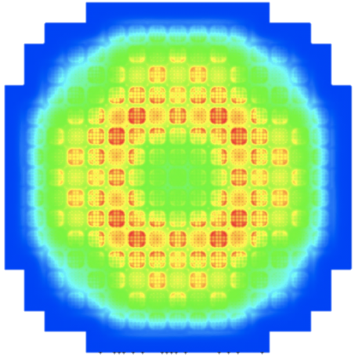
A Reality Check
Fuel assembly and reactor core design are complex engineering challenges. We’ve simplified things a bit in our cartoon.

Slide 28
Let’s Build a Nuclear Power Plant
The fuel rods are grouped together in a regular array or fuel assembly
The fuel assemblies are arranged in a larger regular array or reactor core
The reactor core is contained inside a heavy steel reactor pressure vessel (RPV)

Slide 29
Let’s Build a Nuclear Power Plant
Turbine/
Generator
Condenser
Pump
In a nuclear power plant, the reactor core replaces the burning fossil fuel as the energy source

Slide 30
Let’s Build a Nuclear Power Plant
Turbine/
Generator
Condenser
Pump
Control rods absorb neutrons and are used to stop/start the reaction.

Slide 31
What’s so CRITICAL?
CRITICAL
  # of Neutrons Produced EQUALS # of Neutrons Absorbed
SUB-Critical
  # of Neutrons Produced is LESS THAN # of Neutrons Absorbed
SUPER-Critical
  # of Neutrons Produced is GREATER THAN # of Neutrons Absorbed

Slide 32
Boiling Water Reactor (BWR)
Turbine/
Generator
Condenser
Pump
39 of the 104 nuclear power plants in the U.S. look like this
They’re called BWRs or Boiling Water Reactors

Slide 33
Pressurized Water Reactor (PWR)
Turbine/
Generator
Condenser
Pump
Most U.S. nuclear power plants are PWRs or Pressurized Water Reactors
Steam is made in a steam generator rather than directly in the reactor core
Pump

Slide 34
PWR Containment
Turbine/
Generator
Condenser
Pump
Pump
The entire reactor sits inside a large concrete and steel containment building

Slide 35
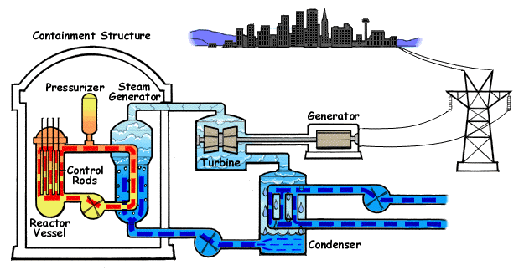
Pressurized Water Reactor

Slide 36
BWR Containment
Turbine/
Generator
Condenser
Pump
The entire reactor sits inside a large concrete and steel containment building

Slide 37
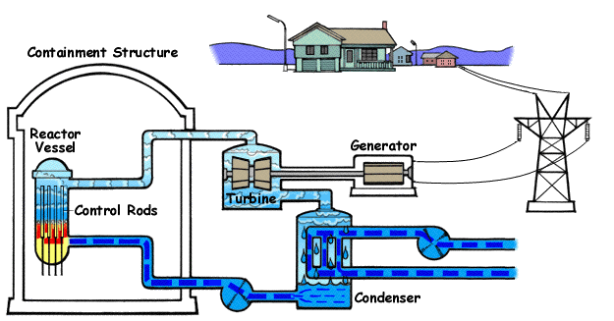
Boiling Water Reactor

Slide 38
POP QUIZ!!!
Which type of reactor is this? PWR or BWR?

Slide 39
POP QUIZ!!!
Hint: It has a steam generator.

Slide 40
POP QUIZ!!!
It is a PWR!

Slide 41
Where is the Reactor?

Slide 42
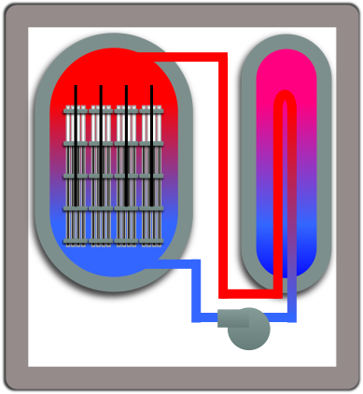
Where is the Reactor?

Slide 43
Then what are these?

Slide 44
Cooling Towers
They chill the cold water used by the condenser.

Slide 45
BWR Containment
Turbine/
Generator
Condenser
Pump
Find the cooling towers!

Slide 46
Boiling Water Reactor

Slide 47
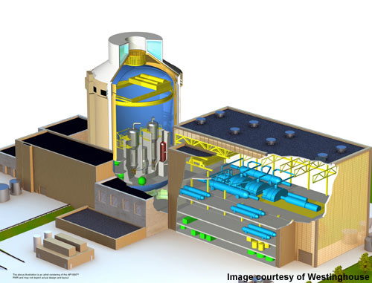
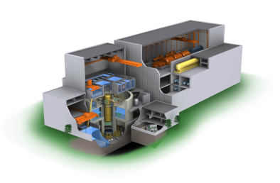
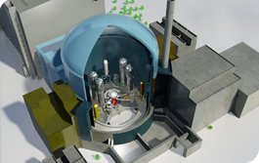
What have we left out of this presentation?
Instrumentation
Systems for optimizing efficiency
  Control system components used by operators
  Steam system components for thermodynamic efficiency
Equipment to support outages and refueling
Safety Systems

Slide 48
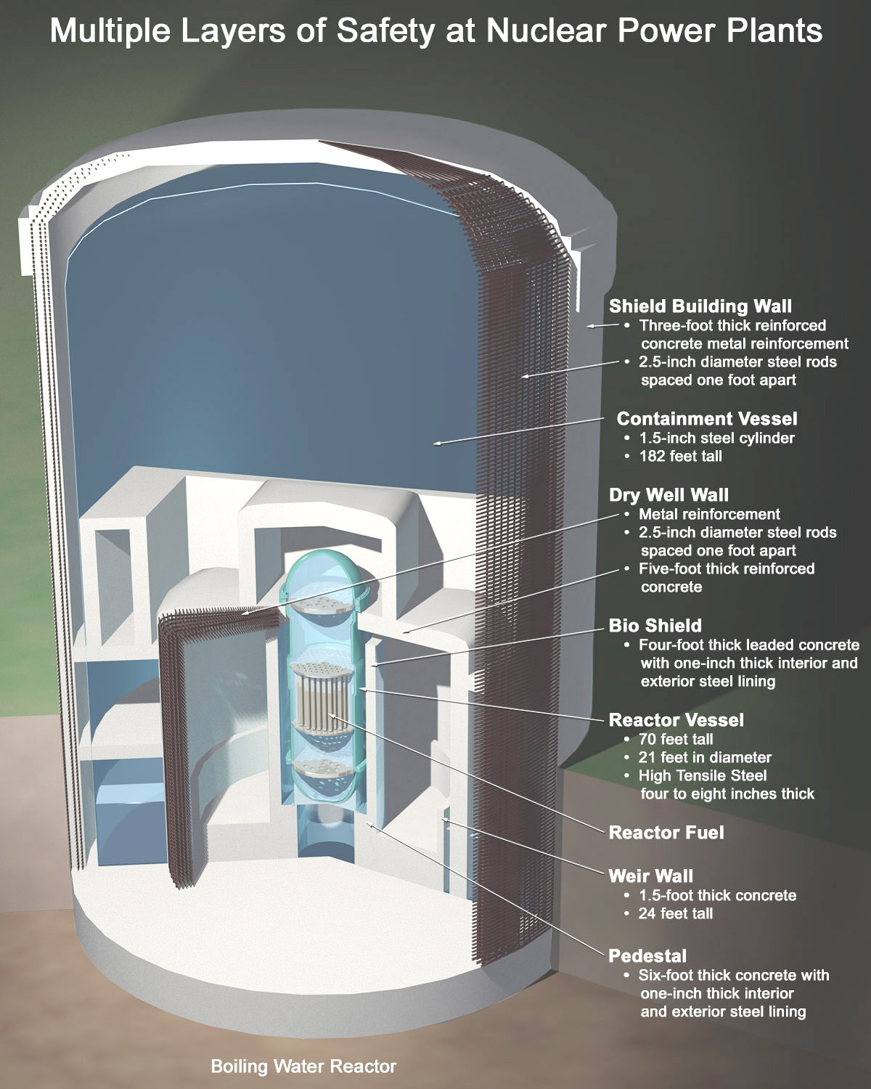
A few words about SAFETY
Reactor designs provide two primary safety functions
Contain radioactive material to protect the public
  Many layers of containment
Maintain ability to cool the fuel
  Emergency Core Cooling Systems to move additional cooling water through the core during accident scenarios
  Pumps driven by offsite power
    Backup battery power
    Backup diesel generators

Slide 49
Advanced Reactors
Generation III+ reactors have more safety systems that are driven by natural forces like gravity and natural convection.
  Less susceptible to interruptions in offsite power and less reliant on backup diesel generators
  Small Modular Reactors
Generation IV reactors use alternative coolants such as helium, liquid metals, or molten salts.
  Operate at higher temperatures and offer improved efficiency
  More safety features which rely on natural forces
  May offer opportunities to better utilize fuel resources

Slide 50
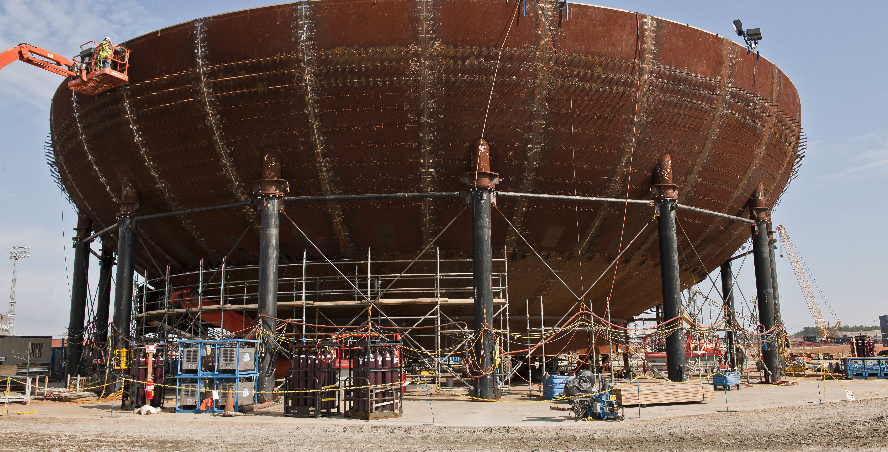
Nuclear Energy 101
Questions? Send them to neoutreach@anl.gov

